Slide 1
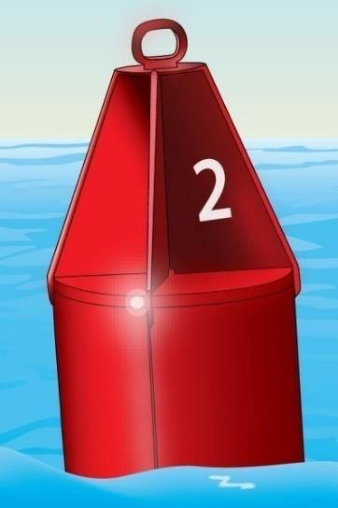
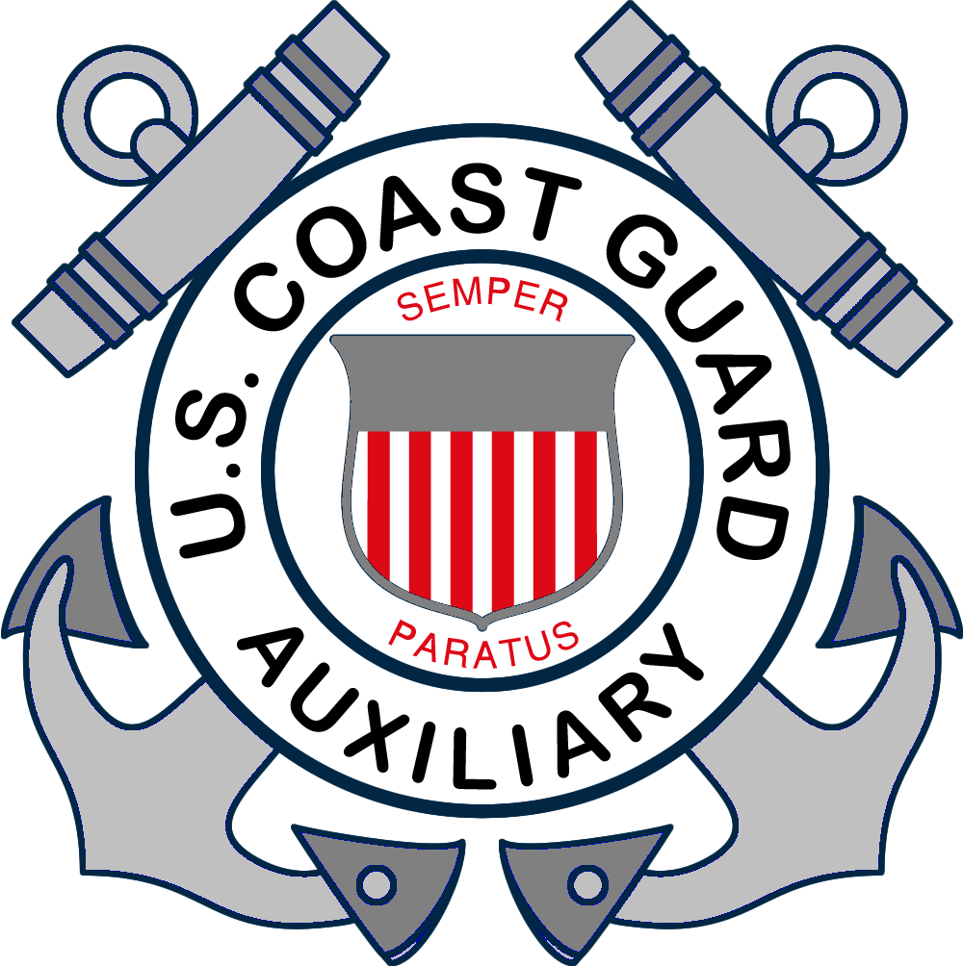
Capitulo 3
NAVEGANDO CON PRUDENCIA

Slide 2
Temas Claves
Reglas de navegación
Luces de navegación
Navegando de noche
Ayudas a la navegación
Brujulas y cartas náuticas
Señales acústicas
Notes:
Instructor Notes:
Introduce these topics quickly as each will be detailed in later slides.
Instructor notes also reference Navrule numbers and in many cases, multiple Navrules apply to the situations depicted. It is not important for the student to know the Navrule specifically, but what it means in plain English. You are teaching the concepts – not the rules. Students can procure or download a copy of the Navrules from the Coast Guard Navcenter at https://www.navcen.uscg.gov/ if they want detailed information.

Slide 3
Temas Claves
Zarpando y atracando
Anclando
Operación de motos acuaticas (PWC)
Interruptores del motor
Cambios del nivel del agua
Represas, exclusas y puentes
Notes:
Instructor Notes:
Introduce these topics quickly as each will be detailed in later slides.

Slide 4
Debe saber como…
Explicar las tres responsabilidades principales del operador de un barco
Explicar maniobras al encontrar otras naves
Enumerar los tipos de luces de navegación nocturnas y explicar cómo interpretarlas
Explicar como interpretar las boyas y marcadores ( ATON ) de los E.E.U.U.
Notes:
Instructor Notes:
Key objectives of Chapter three

Slide 5
Debe saber como…
Usar las señales de sonido
Zarpar y atracar bajo diferentes vientos y corrientes
Anclar con seguridad
Operar una moto acuática con cortesía y precaucion
Notes:
Instructor Notes:
Key objectives of Chapter three

Slide 6
Debe saber como…
Explicar cómo funciona el interruptor del motor
Explicar cómo utilizar la brujula y leer una carta náutica
Explicar como encarar varios peligros: represas, exclusas o puentes y cambios de niveles de agua
Notes:
Instructor Notes:
Key objectives of Chapter three
Compass and Nautical charts not covered in detail – only introduced in this course.

Slide 7
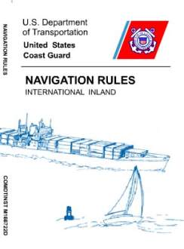
Reglas de Navegación
Las tres reglas básicas de navegación son:
Observar buena navegación Mantener atención y vigilancia
Mantener la velocidad prudente
Uno se puede desviar de las reglas de navegación solo si hay peligro inminente de choque
Notes:
Instructor Notes:
Test question 39. What should a vessel operator do to keep a proper lookout? Answer- Watch for navigational hazards.
Test question 41. Why should a vessel operator keep a proper lookout? Answer – To avoid collisions.
Failure to do any of these three bullet points on the slide are the primary causes of boating accidents.
Navrules
Can be downloaded from the Coast Guard Navigation Center at https://www.navcen.uscg.gov/
Also available on the Coast Guard app in IOS and Android
Seamanship is rule 2
Lookout is rule 5
Speed is rule 6

Slide 8
Reglas de Navegación
Responsabilidades…
Todos los navegantes son responsables de evitar accidentes. Especialmente cada capitan.
Si tiene que desviarse de las reglas, tome esa decisión asesorando:
todos los peligros de la navegación, visibilidad, tráfico, mal tiempo
El riesgo de choques
Cualquier otra condición peligrosa o especial
Notes:
Instructor Notes:
Test question 22. When two vessels are operating in the same general area, who is responsible for avoiding a collision? Answer – The operator of BOTH vessels.
Do whatever you need to do to avoid collision. Everyone needs to lookout for the other guy and be prepared to take evasive action, change course, or stop to prevent a collision. This is Rule 2

Slide 9
Reglas de Navegación
Socorro
La ley requiere a todo navegante parar y prestar socorro a los barcos en peligro,
…a menos que prestar dicho socorro le pondria a Ud., su barco, su tripulación, o sus pasajeros en peligro
Notes:
Instructor Notes:
Test question 22. When two vessels are operating in the same general area, who is responsible for avoiding a collision? Answer – The operator of BOTH vessels.
Do whatever you need to do to avoid collision. Everyone needs to lookout for the other guy and be prepared to take evasive action, change course, or stop to prevent a collision. This is Rule 2

Slide 10
Reglas de Navegación
La acción que debe tomar un operador cuando se vea otro barco depende de:
¿Qué tipo de propulsión tiene?
¿Cómo se acercan los dos barcos el uno al otro?
¿Quién es el que cede el derecho de paso?
Notes:
Instructor Notes:
Test question 25. When is a sailboat under sail the GIVE WAY vessel when encountering a power driven vessel? Answer – When the sailboat is OVERTAKING the power driven vessel.
Meeting, Crossing, Overtaking are three situations where boater need to know what actions they are required to perform.
Two power boats – depends on position and direction and speed of travel
Power and Sail – power give way - sail is stand on EXCEPT when overtaking. In every case, the overtaking vessel is the give way vessel.
Two sail boats – With the wind on the same side, the sailboat on the starboard tack stands on. On different sides, the boat to the downwind side (leeward) is the stand on vessel.

Slide 11
Reglas de Navegación
Siempre ceda el paso a:
Barcos anclados o descapacitados
Naves restringidas en su capacidad de maniobrar
Embarcaciones limitadas por su calado
Buques de pesca comercial con redes en el agua

Slide 12
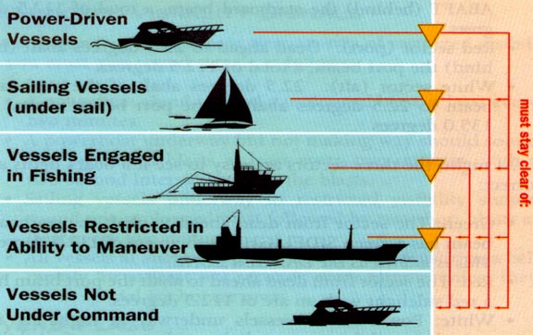
Jerarquía de maniobrabilidad
Barco a motor
Velero no a motor
Pesca commercial
Restringido
Sin control
Notes:
Instructor Notes: Ask if the students can guess if there is a higher category than those shown on the slide. The higher category of boats must stay clear of those below it.
A sailboat under power is considered a Powerboat.
One additional category not shown is the seaplane at the very top of the list

Slide 13
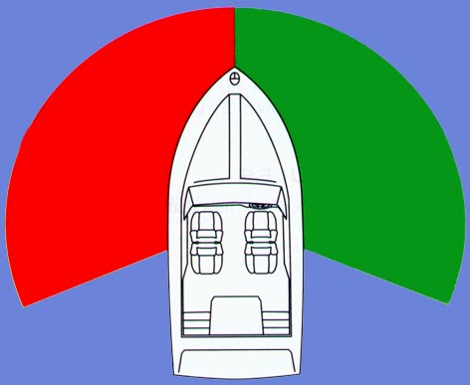
Sectores de visibilidad
White Sector
112.5º
112.5º
Sector rojo
Sector verde
Sector Blanco 135°
Notes:
This slide sets up the basis for the Navrules as they pertain to stand on versus give way and identifies direction of vessels at night. Spend enough time so the students completely understand this slide and it’s importance.
Explain significance of colors – red equals danger, stop, don’t go here. Green means go, safe to proceed, etc.
Ask if any student can identify why most boats pilots position is on starboard side. Starboard side pilot placement provides unrestricted visibility to your “danger zone.”
Explain “danger zone” is to their right from straight ahead to 112.5 degrees. Any other vessel appearing in this area – you are give way vessel. A vessel appearing anywhere else (in red or white sectors) you are stand on vessel.

Slide 14
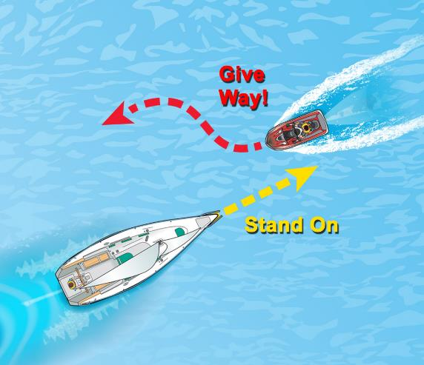
Reglas de Navegacion
Las dos terminologías para explicar como actuar cuando se encuentren con otras embarcaciones.
Cede el paso
Sigue el rumbo
Notes:
Instructor Notes:
Test question 46. What should the operators of a PWC and a motorboat do when approaching head-on? Answer – Both vessels should turn to starboard (right). This is preferred and the correct answer to the test question, but the Navrules allow passing on either side when there are no other obstructions.
Give Way Vessel must stay out of the way of other boats. Slowing down and changing course noticeably are visual signs to other boats that you are altering course to avoid collision.
Stand on Vessel must maintain course and speed and act in a predictable manner so the give way boats can decide what maneuver they need to make to stay clear and avoid collision.
If the give way vessel does not take appropriate action and a risk of collision exists, then you as the stand on vessel must break the rule and change speed or course to avoid collision even though it breaks the rule. Avoid collision at all costs – even running aground is preferable to collision! This is Rule 2 of the Navrules.
Discuss: that a sailboat with it’s engine running, either with or without sails raised, is considered by the Nerveless to be a power-driven vessel

Slide 15
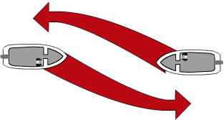
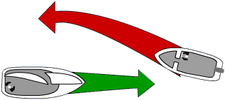
Encuentro Frente a Frente
Barcos a motor…..
Cede el paso..
Cede el paso..
Cede el
Paso..
Velero..
Sigue rumbo..
Notes:
Ask: If two powerboats are meeting head on, which one is the give way vessel? If one is a sailboat, which gives way?

Slide 16
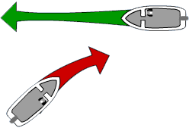
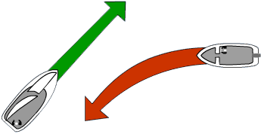
Cruce
A motor…
Sigue el rumbo
A motor…
Cede el paso
A motor…
Cede el paso
Velero…
Sigue el rumbo
Notes:
Instructor Notes:
Before animating slide:
Ask: If two powerboats are crossing, which one gives way? If one is a sailboat, which gives way?

Slide 17
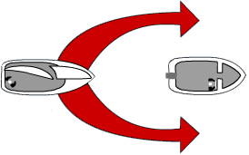
Situación de Alcance
“A” Cede el paso
“B’’
Sigue el rumbo
Notes:
Instructor Notes: Test question 35 When Boat “A” is overtaking boat “B” in a narrow channel, boat “A” is the give way boat. (pg. 16)
Before animating slide:
Ask: Who gives way when one boat overtakes another? If one is a sailboat, which gives way?

Slide 18
Canales Estrechos
Cuando este operando en un canal estrecho, manténgase tan cerca del límite exterior del canal a su lado de estribor, (derecha), como sea más seguro y práctico

Slide 19
Reglas de Navegacion
Navegación durante la visibilidad restringida
Mantenga una velocidad prudente para las condiciones Reduzca la velocidad para evitar una colisión Reduzca la velocidad a primera velocidad si es necesario
Notes:
Instructor Notes:
Test question 23. How do you know when you are operating your vessel at a safe speed? Answer – You have enough time to avoid a collision.
Test question 45. What determines if a speed is safe for your boat? Answer – Visibility conditions.
Safe speed is Rule 6. Excessive speed is high on the list of the things that are contributing factors to accidents and if one occurs, a slower speed impact causes less damage to the vessel and occupants than one at higher speed. Slow down when visibility is limited (darkness, fog, etc.) and in areas without clear sight lines.

Slide 20
Navegacion Nocturna
Los barcos deben usar luces de navegación:
Desde el atardecer hasta el amanecer Cuando la visibilidad este limitada
Las luces indican y le dicen.....:
Si el otro buque esta bajo motor o bajo vela ¿En que dirección va la otra nave? Siga las mismas reglas de navegación utilizadas durante el día
Notes:
Instructor Notes:
Test question 47. When must navigation lights be displayed? Answer – From sunset to sunrise and when visibility is restricted. (Some states may have more restrictive rules and you must differentiate between the federal requirements for this test question and any state differences that may be covered in state supplements)
Test question 49. Visibility is restricted due to fog. What should the vessel operator do to avoid the risk of collision? Answer – Reduce speed to the minimum necessary to stay on course.
This is also Rule 6
State laws may vary when Navigation lights must be illuminated. Know your state laws and quote them here. Proactively, turn them on at the first sign that visibility is deteriorating even if not legally required.
Different light configurations are shown in the text book. Point out the various combinations of red, green, and white lights and what colors you see give you clues about the direction and possibly the type of vessel about to be encountered.
Don’t forget it is very easy to confuse the lights of boats on the water with background lights of things on shore. Familiarity with the area during daylight hours in good visibility helps establish a point of reference when the same area is transited in periods of darkness or reduced visibility. Slow down and come to a stop if you are not certain about what lights you see are telling you so you can take appropriate actions.

Slide 21
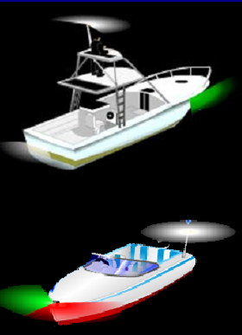
Luces Nocturnas
Luces de proa
Luces de popa
Luz mástil
Luz blanca todo alrededor
Notes:
Instructor Notes:
Before animating slide:
Ask: Why do boats have lights?
To identify the type of boat
To identify which boat is stand on and give way.
Ask: What are the colors and names of the lights you need?
Discuss arc of visibility for each.
Point out that sailboats under sail do not display a masthead light.
Side lights
Red and green seen at front of boat
Stern lights
White seen at rear of boat
Masthead light
White seen from forward and sides
All round white light
Seen from all directions

Slide 22
NAVEGACIÓN NOCTURNA
Luces de remolque
Cuando los barcos comerciales están remolcando, muestran una o más luces amarillas en lugar de una luz de popa.
Notes:
Instructor Notes:
This is Rule 24. Yellow light is the universal signal for towing behind or pushing ahead. Different tow vessel light configurations are for different towing situations and lengths of tows. Just like the law of Gross Tonnage (not in the Navrules anywhere) if it has more lights than you do, stay out of the way.
Emphasize that there may be many yards between the vessel towing and being towed and the danger of crossing between the two.
Point out the two white masthead lights, indicating a vessel towing.

Slide 23
LUCES EN BUQUES DE REMOLQUE
Luz amarilla
Nota: El espacio sin iluminación puede ser de varios cientos de metros entre las luces de la proa y la popa
Notes:
Emphasize that there may be many yards between the vessel towing and being towed and the danger of crossing between the two.
Point out the two white masthead lights, indicating a vessel towing.

Slide 24
Sistema de Navegación EE.UU.
Marcadores laterales
Boya cilindrica Verde
Números impares
Forma de cono Roja
Números pares
Notes:
Instructor Notes:
Test question 24. What is the main purpose of the lateral system of red and green buoys and markers? Answer – To mark the edges of safe water areas.
Greens will always be odd number and reds will always be even numbered. In reduced visibility or at a distance, you can tell the shape of the ATON before you can tell the color and you can tell the color before you can read the number. Note that greens are shaped like a can and reds are shaped like a Nun’s cap, therefore the names can and nun buoys.

Slide 25
Sistema de Navegación EE.UU.
Boyas iluminadas - Parpadean
Colores y luces verdes
Colores y luces rojas
Notes:
Instructor Notes:
Light will indicate color of the marker for navigational reference. All lighted buoys will have different flashing patterns which correspond to the symbol on the chart. This allows differentiation of each specific ATON at night.

Slide 26
Sistema de Navegación EE.UU.
Marcas de día (en postes fijos)
Cuadrado, Verde Reflectivo, Números Impares.
Triangulo, Rojo Reflectivo, Números pares
Notes:
Instructor Notes:
All ATONS are reflective of light and of radar if your boat is equipped with radar. ATONS such as these are on fixed posts or pilings which indicate that they are embedded in the bottom and it is shallow in the vicinity of the ATON. Give any fixed marker a wide berth and don’t get too close.

Slide 27
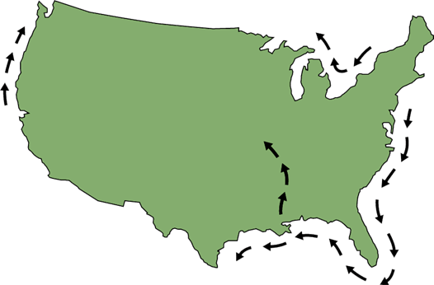
Sistema de Navegación EE.UU.
“Entrando o Volviendo del mar Rojo a la Derecha”
”Red Right Returning”
Cuando navegue alrededor de los EE.UU., si va en el sentido del reloj, usted estára regresando del mar

Slide 28
Sistema de Navegación EE.UU.
“Entrando, o Volviendo, del mar, Rojo a la Derecha”
”Red Right Returning”
Notes:
Instructor Notes:
When returning from sea or going upstream in a river or creek, when you are going in the direction from the sea to the origination of the waterway upstream, keep the reds on the right. Conversely, the greens will be on the left. When going downstream back toward the sea and away from the origin of the waterway, you would keep the greens on the right and reds on the left. Remember this by the mnemonic “Red, Right, Returning”.

Slide 29
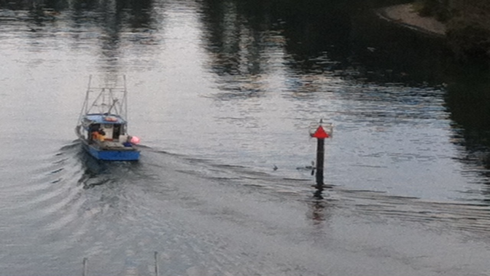
Sistema de Navegación EE.UU.
“Entrando o Volviendo del mar Rojo a la Derecha”
”Red Right Returning”

Slide 30
Sistema de Navegación EE.UU.
Los símbolos amarillos indicant los marcadores laterals del Intra Coastal Waterway (ICW)
Manténga a babor (izquierda)
Manténga a estribor (derecha)
Notes:
Instructor Notes:
When in the Intercoastal Waterway, the red, right, returning follows a clockwise direction around the US. If you start in Norfolk VA and are going to Miami on the east coast of the US, then keep the reds on the right.
However, the ICW intersects various inlets from the ocean and there is a system to differentiate between ATONs that mark the safe water for an inlet and the safe water for the ICW. This special marking is yellow squares (treat it as a green marker) or a yellow triangle (treat it as a red). This indicates you are following the ICW and then you can correlate with your charts the numbers on the ATON to confirm where you are. Notice that the fixed ATONS in this illustration are green squares and red triangles which also correspond to the yellow squares and yellow triangles.
However, ANYWHERE the ICW intersects an inlet, caution MUST be taken to follow the yellow squares or yellow triangles. Sometimes, a single ATON will serve as a marker for both the ICW and the inlet and NOT ALWAYS are they on the same color ATON you expect them to be on. An example is a green ATON marking the right side of an inlet from the ocean, but containing a yellow triangle. This means keep it to the right if coming in from the ocean, and also to keep it to your right and treat it as a red marker if you are traveling southbound on the east coast of the US. If you treated it as a yellow square which you would expect to see on a green painted ATON, you would pass on the wrong side and possibly run aground.

Slide 31
Sistema de Navegación EE.UU.
Un marcador del sistema de los Ríos Occidentales
Indica 73.5 millas de la desembocadura del río
Notes:
Instructor Notes:
These are statute miles in the inland rivers. Charts reference the river miles and often marinas and other services reference the mile marker for their locations. It works in a similar fashion to highways and interstates.

Slide 32
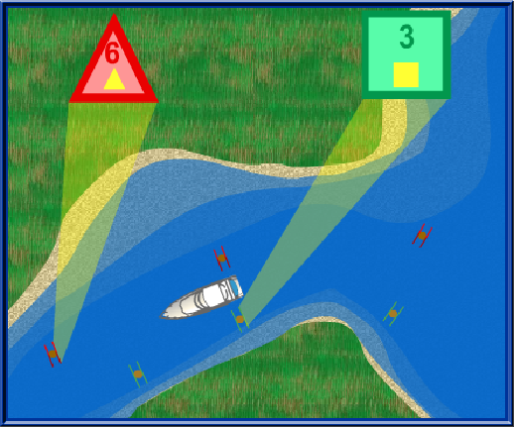
Sistema de Navegación EE.UU.
Símbolos del Intra Coastal Waterway (ICW)
Notes:
Be especially careful when following the ICW near inlets as sometimes the ICW yellow markings may be on a Navaid marking the inlet and may or may not be on a color or shape marker as you expect. It is possible to have a yellow triangle on a green inlet marker and a yellow square on a red inlet marker. This apparent conflict only occurs near inlets where the ICW intersects.
Follow the proper markings for the route you intend to follow. If you are following the ICW and you wish to continue to follow it past the inlet, only pay attention to the yellow marks and disregard the shape or color of buoy or daymark they appear on.
Reconcile your position with a chart to insure safe passage.

Slide 33
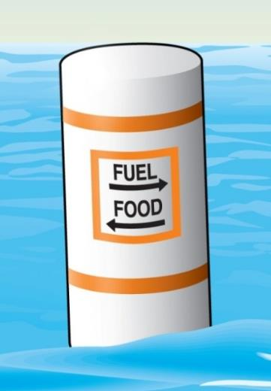
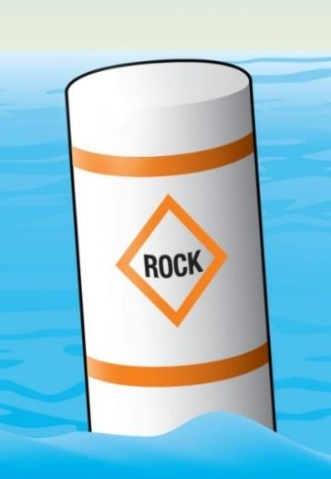
Sistema de Navegación EE.UU.
Marcadores No laterales
Información
Zona de Peligro
Notes:
Instructor Notes:
Square box indicates information. It is not regulatory or restrictive.
Triangle indicates danger in the area.

Slide 34
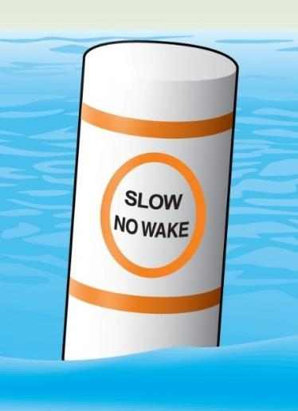
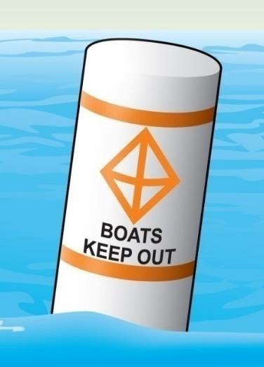
Sistema de Navegación EE.UU.
Marcadores No laterales
Zona controlada
Zona de exclusión
Notes:
Instructor Notes:
Test question 27. What is indicated if you see a white marker that has an orange crossed diamond and black lettering on it? Answer – Exclusion or keep out area such as a dam.
A controlled area has restrictions or limitations. No wake means just that – slow enough that your boat does not produce a wake from the bow. You may need to place the gear shift in neutral and shift in and out of gear to maintain slow enough speed if you have a higher horsepower boat. Note that in windy weather or conditions with strong current, you must maintain enough power for directional control even if it causes a small wake. Do not loose steering control regardless of the restriction on wake.
The exclusion means just that – do not go here!

Slide 35
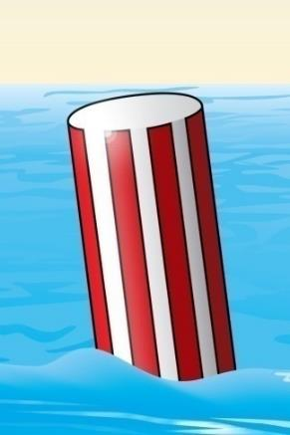
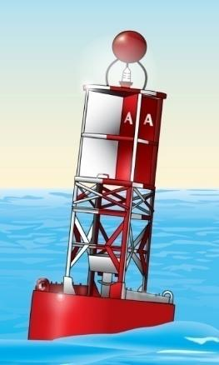
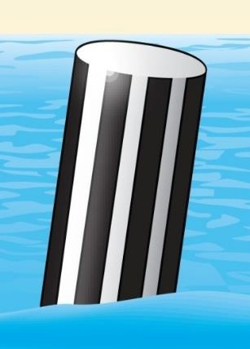
Sistema de Navegación EE.UU.
Otros marcadores no laterales
Marcador de Obstrucción en Ríos y Aguas Interiores,
Marcadores de aguas navegables
Notes:
Instructor Notes:
Sometimes referred as the “sea buoy” which means that now you have reached the end of the marked channel and the water is safe for navigation all around. If coming into a channel from sea, plot this buoy as your point to begin your course in the marked waterway. Do not plot your course DIRECTLTY on the ATON, but a few yards away is OK.
The black stripe buoy is used on inland lakes and rivers to indicate the “end of the reef” which means DO NOT PASS BETWEEN THIS MARKER AND THE NEAREST SHORE! Often there are other intermediate markers on fixed poles to indicate the line of obstruction. Give these areas a wide berth as they are often on fixed poles which means shallow water around them.

Slide 36
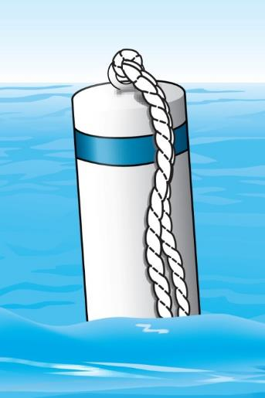
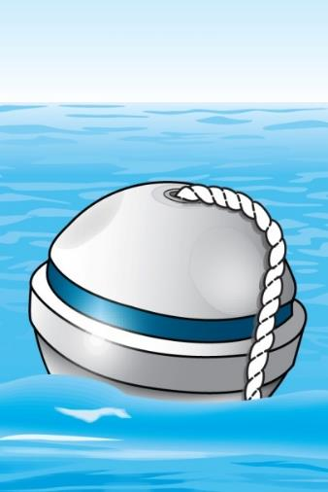
Sistema de Navegación EE.UU.
Otros marcadores no laterales
Boyas de Amarre
Notes:
Instructor Notes:
These are designed for boaters to tie up without the need to deploy an anchor. Often, they are laid out in an efficient pattern that allows many other boats to use a designated anchorage and have sufficient swing room as wind or current conditions change. Every part of the buoy that touches the water will be slimy so be prepared with gloves as you pick up the pendant to attach a short line from your boat to the pendant. The line is anchored to the bottom securely. Look at other boats in the anchorage to see how much line they have out. If you match that length, the entire anchorage will swing in unison and no one will tangle up with another boat (at least in theory).

Slide 37
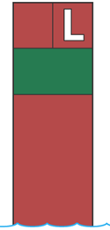
Sistema de Navegación EE.UU.
Boyas de cruce y union de dos vías
A
B
verde
rojo
Notes:
Junction buoys indicates a split in a channel. The upper band tells the boater which channel is the preferred channel. The preferred channel is the deepest and widest channel. A boater may need to go into the non-preferred channel to get to their dock, local restaurant, fuel, etc.

Slide 38
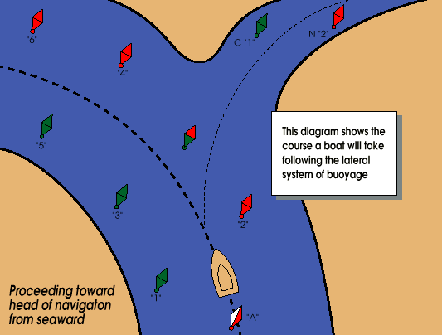
Sistema de Navegación EE.UU.
Boyas de Cruce:
Rumbo usando laterales
Entrando del mar
Notes:
This boat approaches the channel and sees a junction buoy with a red top band. Which course will the boat follow to stay in the preferred channel?

Slide 39
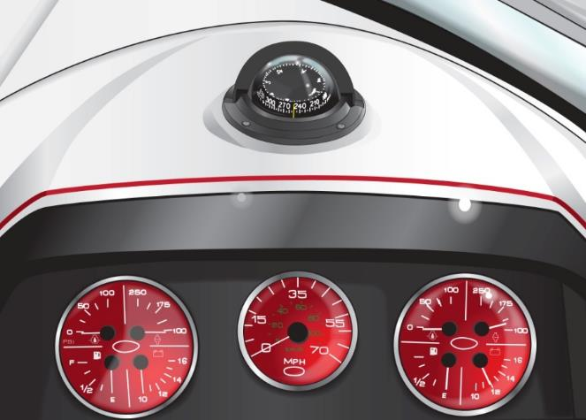
Brújulas
Brújula montada en la consola
Puede ser invaluable en mal tiempo
Equipos metálicos como hierro, imanes y cables eléctricos afectan su direccion. Alejelos de la brujula. Tambien teléfonos, binoculars, etc.
Notes:
Instructor Notes:
Correlate your direction as read on the compass with a chart and along with ATON sightings and a chart, you can quickly find where you are in relation to where you think you are. Electric current and magnets affect the ability of the compass to show your current heading. When installing a new compass, engage each electrical component while watching the compass to see if turning on that electrical load has any affect on the compass. Simply rerouting any interfering equipment or power runs to the equipment will solve most issues

Slide 40
Cartas Náuticas Locales
En bahías, rios, o lagos grandes, las cartas náuticas detallan:
Los profundidades del agua
Dónde hay arena, rocas, vegetación y canales navegables
La via más directa y segura
Las muelles más cercanos
Notes:
Instructor Notes:
Be careful not to turn this into a navigation class. You may wish to mention the Weekend Navigator or other Auxiliary navigation products as an additional class for those who are interested. You may wish to pull out a local chart and show a few features and especially any areas of concern or challenging areas.

Slide 41
Símbolos en la Carta Náutica
Notes:
Instructor Notes:
Briefly explain the symbols on the chart above. Cover the RG “A” and what that means with primary and secondary channels. Also cover the flashing light characteristics and the tank light on shore.

Slide 42
SEÑALES BASADAS EN SONIDOS
Las señales acústicas utilizan sonidos cortos y prolongados.
Deben ser audibles por lo menos a media milla.
Sonido corto: Aproximadamente un segundo de duración
Sonido prolongado: 4-6 segundos de duración (Bocina, claxon, silbato, campana, etc..)
Notes:
ASK: Why we use sound signals:
We use sound signals to alert other boats to
our intentions
identify our boat type and position in restricted visibility
ASK: what is a prolonged and a short blast?
Short Blast : About One Second Long
Prolonged Blast : 4 to 6 Seconds

Slide 43
SEÑALES BASADAS EN SONIDOS
Cambios de dirección con sonidos acústicos fuertes:
Una sonido corto: Quiere pasar al otro barco por estribor
Dos sonidos cortos: Quiere pasar al otro barco por babor
Tres sonidos cortos: Estoy poniendo mi barco en reversa. (Marcha atrás)
Notes:
Instructor Notes:
This section is one of the most confusing to new boaters. The way the Navrules and the book is written can confuse which signal to use. Instead of the examples used in the book which indicate the direction you intend to pass the OTHER boat, perhaps the following reference to which way the boater needs to TURN may help in understanding.
One short blast means “I am turning to the right (my starboard) to pass you.
Two short blasts means “I am turning to the left (my port) to pass you.
Three short blasts means “I am operating in reverse propulsion” or “I am backing up”..
One good way to teach this is to think about an analog lock and the minute hands. When the minute hands point toward the 1 o’clock position, it is to the right of center and you are pointing your boat in that direction. This is a “one whistle” or on the radio would translate to “passing you on the ones”.
Conversely, if the minute hand is pointing toward the 11 o’clock position, think of it as two “ones” or added together making a “two”. This means your boat is pointing to the left of center. This would be a “two whistle or on the radio would translate to “passing you on the twos.”
This is an easy to remember mnemonic unless your students have only referenced digital clocks and not used analog clocks!

Slide 44
SEÑALES BASADAS EN SONIDO
Cuando hay poca visibilidad y en movimiento:
Una sonido prolongado cada dos minutos (con motor).
Una sonido prolongado, más dos sonidos cortos, cada dos minutos (velero)
Notes:
Instructor Notes:
One prolonged blast every two minutes is the signal used by power driven vessels when underway.
One prolonged blast plus two short blasts every two minutes is the signal used by sailing vessels when underway.

Slide 45
SEÑALES BASADAS EN SONIDOS
Cuando hay algún peligro o emergencia inmediata:
Un sonido prolongado
Cinco o más sonidos rápidos o cortos
Notes:
Instructor Notes:
One long blast is a warning signal and can be used when “getting underway” or coming around a blind bend.
Five or more short indicates disagreement or danger. Stop and reconcile why this sound signal was heard.

Slide 46
ANTES DE SOLTAR AMARRAS
ANTES DE SALIR:
Mantenga el barco atado al muelle mientras el motor se calienta
Asegúrese de que todos estén sentados y usando el salvavidas (PFD-dispositivo de flotación personal )
Compruebe que el motor este funcionando y que el área este libre de tráfico
Notes:
Instructor Notes:
Before starting the engine, run the blower for at least 4 minutes. While blower is evacuating the bilge of any accumulated fumes, conduct a checklist of safety equipment on board and orientate all aboard the location of safety equipment. Check the fit of all in their life jackets and pay particular attention to fitting children in an appropriate size life jacket. Open the engine compartment and sniff before attempting to start engine. If you smell gas fumes – STOP!
Once engine is running, wait for it to warm up to operating temperature. Verify there is sufficient fuel for the journey. Verify that horn and all lights work before leaving the dock. Alert the crew when you put the boat in gear in forward and reverse to verify thrust before casting off the dock lines.
If your boat has a engine shut off safety lanyard on the throttle/shift lever, connect it to your life jacket. By Federal law, the shut off switches are factory installed on boats less than 26 feet in length and are intended to shut off the engine should the operator be separated from the helm resulting in loss of control of the boat.
Verify visually that the way is clear before casting off the lines.

Slide 47
PONERSE EN MARCHA
Si no hay viento ni corriente:
Suelte los cabos de proa y popa. Separe el barco del muelle
Mueva el acelerador lentamente hacia adelante
Empuje y gire gradualmente el barco y apartese del muelle
Avise a los pasajeros de antemano y observe el tráfico
Notes:
Instructor Notes:
The next slide will help illustrate these concepts. Consider using the Boat America video demonstrating casting off and docking techniques.
Ask: for a volunteer to describe casting off with wind/current off the dock.
Release lines
Push boat away
Shift into Forward and ease away
Ask: for a volunteer to describe casting off with wind/current on the dock.
Release stern line – leave bow spring line on
Put into “forward gear”
Boat stern will edge out
Release bow spring line and back out

Slide 48
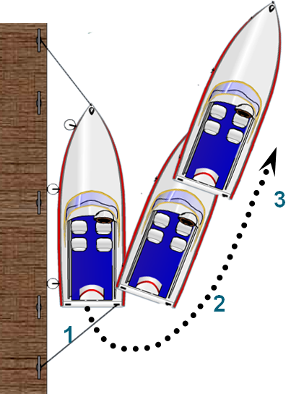
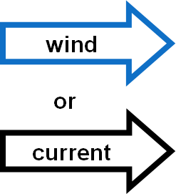
Soltar amarras – viento contra el muelle
Notes:
Instructor Notes:
The next slide will help illustrate these concepts. Consider using the Boat America video demonstrating casting off and docking techniques.
Ask: for a volunteer to describe casting off with wind/current off the dock.
Release lines
Push boat away
Shift into Forward and ease away
Ask: for a volunteer to describe casting off with wind/current on the dock.
Release stern line – leave bow spring line on
Put into “forward gear”
Boat stern will edge out
Release bow spring line and back out

Slide 49
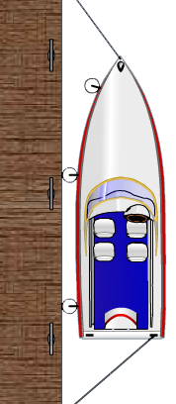
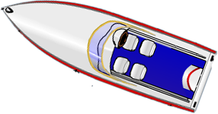
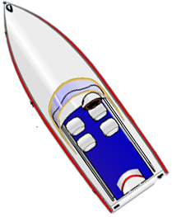
Cómo soltar amarras con el viento y la corriente hacia el muelle
Viento
3
Corriente
2
1
Notes:
Instructor Notes: Control of a boat is from the stern with the engine – you have almost no control of the bow without thrusters
Ask: for a volunteer to describe casting off with wind/current on the dock.
Release stern line – leave bow spring line on
Put into “forward gear”
Boat stern will edge out
Release bow spring line and back out
Instructor Notes: Control of a boat is from the stern with the engine – you have almost no control of the bow without thrusters
Ask: for a volunteer to describe casting off with wind/current on the dock.
Release stern line – leave bow spring line on
Put into “forward gear”
Boat stern will edge out
Release bow spring line and back out

Slide 50
ATRACANDO
A medida que se acerque al muelle
Disminuya la velocidad
Espere a que el tráfico se despeje
Prepare los cabos de proa y popa
Dirígase hacia el viento (barlovento) o la corriente
Ponga las defensas del barco en su lugar
Siente a todos los pasajeros
Notes:
Instructor Notes:
Test question 12. How should you approach the dock when docking your vessel. Answer – into the wind or current, whichever is stronger.
Stand off the dock and come to a complete stop in an open area that allows maneuverability so you can judge the effect of wind or current or both on your boat and how you will need to counteract that motion to successfully dock the boat. Don’t be afraid to stop and start over as many times as needed to avoid uncontrolled motion of the boat that could result in damage to crew or the boat.
Before approaching the dock ASK-
What is the direction of the wind/current?
Are fenders out?
Are dock lines ready?
Crew ready?
SLOW approach
Remind that hands, arms legs, and feet should never be used to fend off. Use boathook!
No Wind or Current
Slow approach
Narrow angle
Step off and secure bow/stern lines
Wind or Current off the dock
Sharp angle of approach
Bow line is secured by tossing a large “loop” around dock cleat and making the line fast to the boat. Adjustments will be made later. Goal is to have bow of boat controlled by bowline to allow use of engine to bring in the stern.
Turn helm hard over towards the dock
Engine in reverse to bring stern in.
Step off and secure bow/stern lines and adjust as needed.
Wind or Current on the dock
Narrow angle becoming parallel close to the dock
Allow wind to push you on – use fenders and boat hooks – NO HANDS OR FEET!
Step off and secure bow/stern lines and adjust as needed.

Slide 51
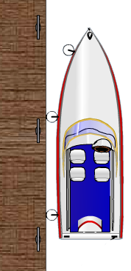
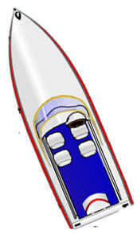
Atracando sin viento ni corriente
3
2
1
Notes:
Instructor Notes:
Ask: what steps are being done here to dock the boat?
Responses:
Slow approach
Narrow angle
Step off and secure bow/stern lines

Slide 52
Atracando con el viento o la corriente en contra del muelle
viento
corriente
3
2
1
Notes:
Instructor Notes:
Ask: for a volunteer to describe docking with wind/current off the dock.
Sharp angle of approach
Bow line is secured
Turn helm hard over towards the dock
Engine in reverse to bring stern in.

Slide 53
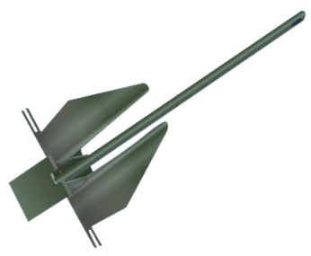
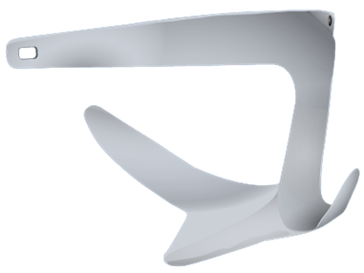
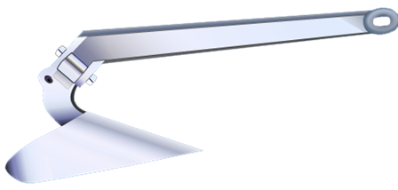
Tipos de anclas
Varian en uso según el fondo
Danforth
Arado
Uña
Notes:
Instructor Notes:
Anchor design determines an anchor’s ability to hook the bottom.
Discuss the different characteristics of these types of anchors.
Ask: What types do the students feel are best for their boat and boating area?

Slide 54
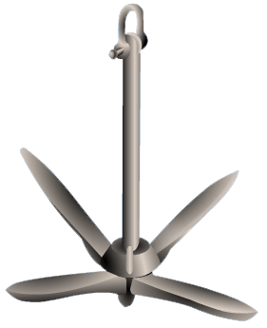
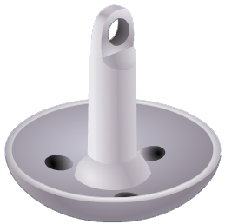
Otros tipos de Anclas
Para usos especiales
Gancho
Hongo
Notes:
Instructor Notes:
Anchor design determines an anchor’s ability to hook the bottom.
Discuss the different characteristics of these types of anchors.
Ask: What types do the students feel are best for their boat and boating area?

Slide 55
Pautas de Anclaje
Al anclar…..
¿Por qué usar cadena? ¿Qué es el alcance?
Notes:
Instructor Notes:
Discuss the two questions:
Responses:
Chain help keeps the anchor flukes flat and allows them to dig into the bottom. It also improves chafe protection where the anchor rode touches the bottom during anchor setting.
Scope is the ratio of rode length to the depth of water.
Classroom aid: bring a small anchor and rode to demonstrate how the scope will keep the anchor flat.

Slide 56
Al Anclar
Guías
Alcance normal …. 7:1
Mares tranquilos …. 5:1
Mal tiempo …. 10:1
Notes:
Instructor Notes:
Demonstrate how to measure rode with outstretched arms.
Ask: Why is more scope needed in heavy weather?

Slide 57
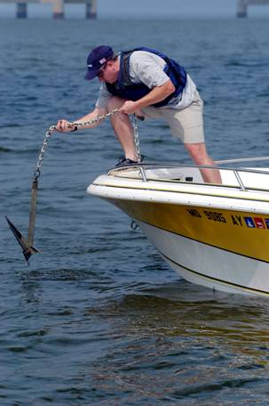
Queremos Anclar
¿Cómo hacemos?
¿Cuáles son los pasos ?
Nunca ancle desde la popa solamente
Notes:
Instructor Notes:
Discuss:
Bitter end of anchor rode
Select sheltered area
Approach into wind/current
Slowly lower anchor
Pay out scope while backing down
Make line fast; back down to set
Check for drift using landmarks
Test Question: What will happen if you anchor a boat from the stern? It may cause the boat to swamp.

Slide 58
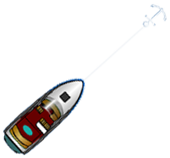
Antes de Fondear
Deje espacio para bornear (girar)
Profundidad y tipo de fondo
Dirección del viento y la corriente
wind
wind
wind
Notes:
Instructor Notes:
Ask: Why is this important? Discuss proximity to other boats, taking a visual marking to the land for location, moving if someone else anchors too close to you.

Slide 59
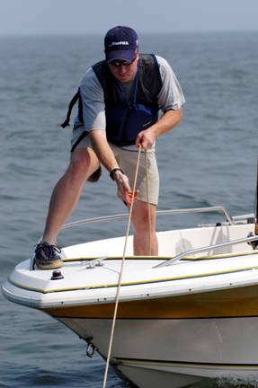
Levantar Ancla
Recuperando el ancla:
¿Cuáles son los pasos?
Notes:
Instructor Notes:
Discuss:
Slowly move ahead while pulling in line.
If anchor sticks, power around in a circle.

Slide 60
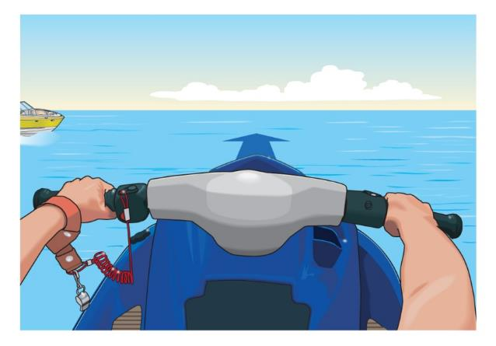
Cómo operar una PWC / Moto Acuática
Dirección y detención de un PWC
La mayoría de las embarcaciones de propulsión a chorro como las motos acuáticas y otros, deben tener potencia para mantener el gobierno, control y la dirección
El operador mantiene presión en la palanca del acelerador y dirige la moto hacia delante.
Notes:
Instructor Notes:
Test question 37. What action may cause loss of steering ability in a PWC? Answer – Letting off the throttle control
Emphasize that without thrust from the nozzle, there is very little to zero steering control on a jet drive. Some PWCs and jet boats have rudders, but water must be moving past the rudder to change direction.
ALWAYS attach the cut off lanyard to you so when you fall off, it shuts down the engine so you can swim to it and re-board.

Slide 61
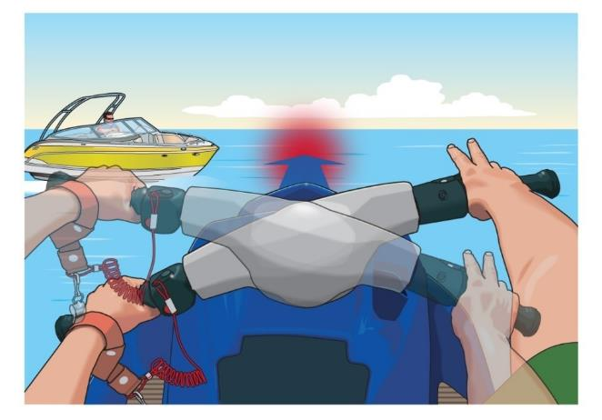
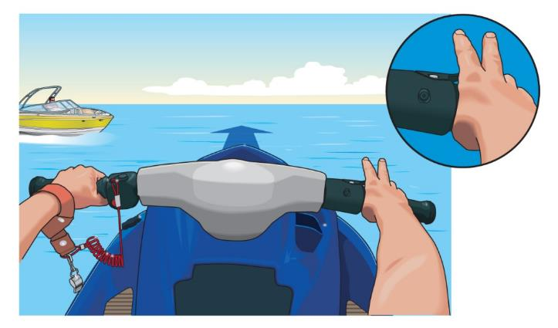
Operando una Embarcación Personal / PWC / Moto Acuática
El operador libera/suelta la palanca del acelerador
El PWC puede seguir recto a pesar de que el operador está tratando de girar a ambos lados
Los PWC más modernos y recientes permiten un poco más de gobierno adicional fuera del acelerador
Notes:
Instructor Notes:
Try to anticipate the “way on” at various speeds and think ahead when it is time to slow down or allow the jet drive to return to idle speed. This is a skill that is only learned by experience and it is best learned in areas that are free of close quarters obstructions

Slide 62
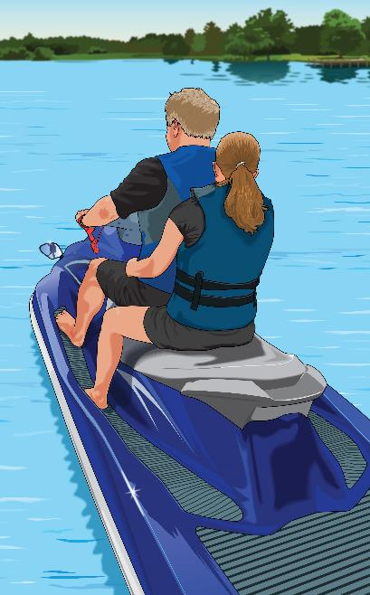
Operando una Embarcación Personal / Moto Acuática
Otras consideraciones
Conozca las regulaciones de su estado Salvavidas son requisitos para montar en moto acuatica. Asegúrese de que su pasajero pueda sujetarse firmemente. No siente a nadie enfrente del operador.
Notes:
Instructor Notes:
Many states have PWC specific rules. Know your state rules and discuss those that apply to PWCs

Slide 63
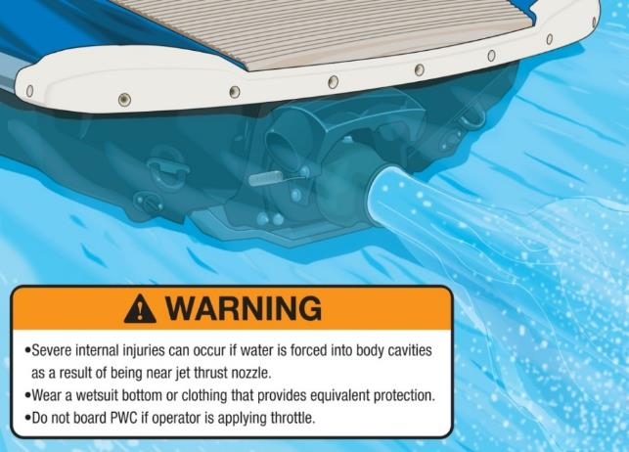
Operando una Moto Acuática
Mantenga las manos, los pies, la ropa y cabellos alejados del área de entrada de agua a la bomba
Use un traje de neopreno o ropa que proporcione protección equivalente
No suba a bordo si el operador esta acelerando
Notes:
Instructor Notes:
Don’t forget that just about anything can get sucked into the water intake including dock and tow lines, shallow water plants and rocks and anything that is in close proximity to the water intake for the impeller.

Slide 64
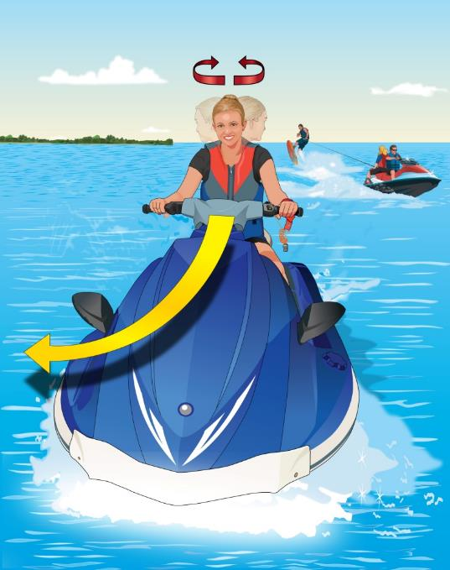
Operando una Embarcación Personal / Moto Acuática
antes de doblar mire a ambos lados y detrás
Tenga en cuenta todo el tráfico que le rodea
Notes:
Instructor Notes:
Always have good situational awareness and look around in addition to using the mirrors. If someone is riding with you, use them to help maintain situational awareness for others coming up from behind. When riding PWCs, it is easy to get tunnel vision and focus on what is directly in front of you which excludes all other directions. You must know what is happening all around you.

Slide 65
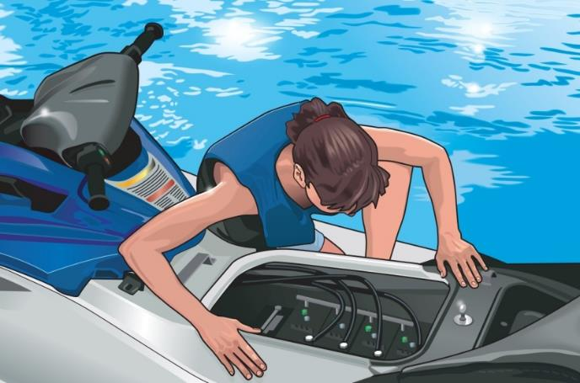
Operando un PWC / Moto Acuática
Inspeccione su sistema electrico. No se olvide de hacer una “prueba de olor” para vapores de gasolina
Evite sobre cargarse Reconozca sus límites y navegue de acuerdo a sus habilidades
Notes:
Instructor Notes:
Use your nose to check for any fuel leaks before attempting to start the PWC.
PWCs are rated for either two or three occupants. This does not mean two people on the PWC and one person being towed behind. You need one seat for each person. Many states have specific towing and capacity rules and may include restrictions, additional equipment, or special seating requirements. Know your state and local laws before teaching this chapter.
Encourage students to start out slow and easy and not to attempt high speed maneuvers or otherwise push the limits of their ability. When users exceed safe limits is when most accidents happen.

Slide 66
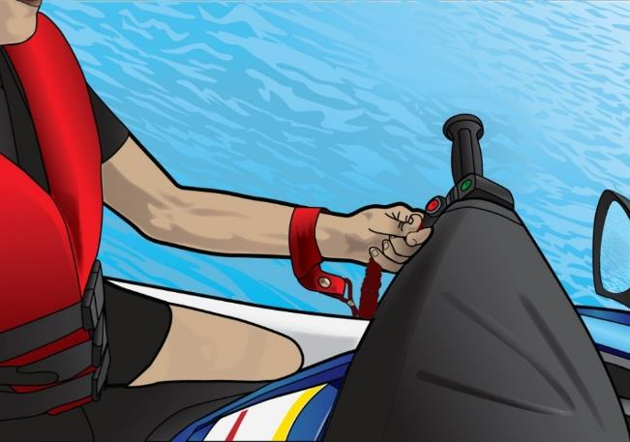
Interruptores de la moto acuatica
Interruptor de seguridad Cordón de amarre Giro automático
Notes:
Instructor Notes:
Test Question 19. What is the main function of an engine cut off switch? Answer – To shut off the engine if the operator is thrown overboard.
Test question 40. What statement regarding PWC is true? Answer – A PWC operator is required to attach the engine cut off switch lanyard to his or her person.
Cut off switch MUST be attached and is required by law in every state.

Slide 67
Cambio en los Niveles de Agua
¿Cuál es su calado?
Tenga en cuenta que los niveles de agua pueden cambiar rápidamente y causar peligros Puede afectar el atraque en un muelle fijo Aprenda sobre los niveles de las mareas altas y bajas locales, y tambien cuando navegue en barco por las aguas costeras Fluctuación de niveles puede causar encalles
Notes:
Instructor Notes:
In tidal areas – KNOW the stages of the tide and where you are in the current tide cycle. Double check depths of the water versus tide state. In certain tidal areas, what was good enough and safe water at high tide becomes exposed mud at low tide. Get local knowledge when tying up your boat to a fixed dock in a tidal area as there are several different configurations and techniques to safely tie off your boat and still allow you to get on and off with various tide conditions.
Understand the tidal forces and how this moving water affects your tie up on a dock and especially at anchor. You may need to use bigger lines or multiple anchors depending on direction and strength of the current or wind or both!
GET LOCAL KNOWEDGE WHEN IN UNFAMILIAR WATERS. If you are not sure, stop and assess the situation and then go slow!
There are several sources of tide information available on-line and most of the mapping software and apps for boating have tide information as part of the app. Become familiar with the effect and the height of the tide in the areas you are transiting.

Slide 68
Navegación por Ríos, Embalses, Esclusas y Puentes
Reduzca la velocidad y proceda con precaución
Compruebe la altura antes de pasar por debajo de un puente
Muchos puentes levadizos se abren a medida que se acerca a él o Ud. se pone en contacto con el operador por radio VHF
Notes:
Instructor Notes:
Charts have bridge clearance marked. There are signboards at bridge pilings so be sure to look at the clearances to be certain you have enough vertical clearance. If you have a sailboat, it is CRITICAL that you know the clearance of any overhead power lines. The posted clearance at bridges are at “low steel” and depending on the construction of the bridge, sometimes the center of the bridge has a bit more clearance. If not certain, approach the bridge at the slowest speed possible and send a crew up top to check for clearance. Sometimes, you can lower an antenna or a Bimini top to gain enough clearance.
Drawbridges and dams usually operate on Marine VHF channel 13 and in some places 14. Charts will give the bridge information including channel or channels monitored and any time opening restrictions. Also, the Local Notice to Mariners may have additional updates for bridges and locks. This is available from the Coast Guard Navcenter and is updated weekly.

Slide 69
Evitar lesiones de la hélice
Apague el motor cuando:
Los pasajeros están subiendo o desembarcando
Alguien está en el agua cerca del barco Evite que los pasajeros se caigan o sean arrojados por la borda accidentalmente Nunca arranque con el acelerador en marcha
No sentarse nunca en el respaldo del asiento, en la borda, popa o la proa
Asegúrese de que todos los pasajeros estén correctamente sentados Asigne a alguien que cuide a los niños
Notes:
Instructor Notes:
Test question 32. What should a motorboat operator do when someone is being pulled into the boat from the water? Answer- Turn the engine off.
Always approach into the wind or the current when there is a person in the water you want to pick up. If you approach from upwind or up current, you will drift over the person in the water. By turning off the engine you eliminate any chance the propeller is turning and could do damage to the person in the water. It is ALWAYS best to have flotation (type IV) with a line attached to it you can throw to the person in the water when you get close which allows you to pull them to you instead of trying to get the boat close to them.
Every boat has an interlock that should prevent the engine stating while in gear, but use caution to be sure no one is near the propeller when the engine is started or when it is running.
Many states have rules on where to sit and what is legal. Just because riding on a gunwale or hanging your legs over the bow of the boat when underway may be legal where you boat, it is really dumb and greatly increases the odds you will be thrown overboard. If you fly out the front of the boat, you WILL get run over as it is impossible to stop the boat in time and you may get hit by the propeller. Sitting in a seat designated for that purpose is essential to safety.
Children sometimes move around unexpectedly, so use caution with small children on board and make sure they are secure anytime you need to make a quick turn that could potentially throw them around inside the boat or worse – overboard! ALL CHILDREN SHOULD BE IN LIFE JACKETS AT ALL TIMES WHEN ON DECK AND NOT IN AN ENCLOSED CABIN. Many states have specific laws regarding children and proper wear of life jackets. Regardless of what is legal, a responsible parent should NEVER allow a child not to be secured in a life jacket. Even if it is not a state rule, make it YOUR rule.

Slide 70
Evitar lesiones de la hélice
Mantenga una vigilancia adecuada para ver las personas en el agua
Disminuya la velocidad al acercarse a áreas congestionadas, anclajes y marinas
Aprenda a reconocer las balizas no laterales de advertencia o informacion
Mantenga su barco alejado de lugares de natación y áreas de buceo
Notes:
Instructor Notes:
White and blue flag is flown from a boat where diving operations are underway. Red and white flag is carried by divers in the water (on a float with line attached to them) which marks their approximate location. STAY WELL CLEAR of either flag. Some states have specific distances for separation so know your state law

Slide 71
DISPOSITIVOS QUE REDUCEN ACCIDENTES DE HÉLICE
ARTÍCULOS DE SEGURIDAD DISPONIBLES
Guardias
Propulsión
Enclavamientos (BLOQUEO)
Sensores
Notes:
Instructor Notes:
Test qustion15. How can propeller strike accidents be avoided? Answer - Turn off the engine when passengers are boarding.
While propeller guards are not required on recreational vessels, propeller guards help in reducing strikes with objects in the water including people.

Slide 72
Capítulo 3 Repasos

Slide 73
Repaso #1
¿Cuál es la mejor manera de informarse sobre los peligros en una vía local?
Consulte la carta náutica local
Consulte un mapa topográfico
Pregúntele a alguien que fue allí hace años
d. Escuche su emisora de TV o de radio favorita

Slide 74
Repaso #1
¿Cuál es la mejor manera de informarse sobre los peligros en una vía local?
Consulte la carta náutica local
Consulte un mapa topográfico
Pregúntele a alguien que fue allí hace años
d. Escuche su emisora de TV o de radio favorita

Slide 75
Repaso #2
¿Cómo se pueden evitar los accidentes con la hélice?
No encender el motor cuando los pasajeros estén subiendo al barco
b. Deje que los pasajeros viajen en la proa mientras
están navegando
Apague el motor cuando los pasajeros estén
embarcando
d. Dejar que los niños se cuiden el uno al otro

Slide 76
Repaso #2
¿Cómo se pueden evitar los accidentes con la hélice?
No encender el motor cuando los pasajeros estén subiendo al barco
b. Deje que los pasajeros viajen en la proa mientras
están navegando
Apague el motor cuando los pasajeros estén
embarcando
d. Dejar que los niños se cuiden el uno al otro

Slide 77
Repaso #3
¿Cuál es la función principal del interruptor de encendido del motor?
Para apagar el motor si el operador es lanzado fuera de la borda
Para apagar el motor cuando el PWC o bote está en tierra
c. Para evitar el uso por personas no autorizadas
d. Para evitar el robo cuando la moto o el barco no estan atendidos

Slide 78
Repaso #3
¿Cuál es la función principal del interruptor de encendido del motor?
Para apagar el motor si el operador es lanzado fuera de la borda
Para apagar el motor cuando el PWC o bote está en tierra
c. Para evitar el uso por personas no autorizadas
d. Para evitar el robo cuando la moto o el barco no estan atendidos

Slide 79
Repaso #4
Cuando dos barcos operan en la misma zona general, ¿Quién es responsable de evitar la colisión?
Los operadores de ambos barcos
El operador del barco que sigue el rumbo
El operador del barco que cede el paso
d. El operador del barco más pequeño

Slide 80
Repaso #4
Cuando dos barcos operan en la misma zona general, ¿Quién es responsable de evitar la colisión?
Los operadores de ambos barcos
El operador del barco que sigue el rumbo
El operador del barco que cede el paso
d. El operador del barco más pequeño

Slide 81
Repaso #5
Qué se indica mediante un rombo blanco con una cruz de color naranja con letras negras?
Área de exclusión, como una presa, área de baño
Zona controlada, como un área de no estela
Información, como lugares para atracar o encontrar alimentos, combustible, etc.
d. Peligro como rocas, poco fondo

Slide 82
Repaso #5
Qué se indica mediante un rombo blanco con una cruz de color naranja con letras negras?
Área de exclusión, como una presa, área de baño
Zona controlada, como un área de no estela
Información, como lugares para atracar o encontrar alimentos, combustible, etc.
d. Peligro como rocas, poco fondo

Slide 83
Repaso #6
¿Qué acción puede causar la pérdida de la capacidad de dirección en una moto acuática?
Velocidad, corriendo con el acelerador al máximo
Soltando el control del acelerador
Sobre-dirección
d. Baja dirección

Slide 84
Repaso #6
¿Qué acción puede causar la pérdida de la capacidad de dirección en una moto acuática?
Velocidad, corriendo con el acelerador al máximo
Soltando el control del acelerador
Sobre-dirección
d. Baja dirección

Slide 85
Repaso #7
¿Qué determina la velocidad más prudente para su barco?
Tipo de motor
Condiciones climáticas
Condiciones de visibilidad
d. Cantidad de combustible disponible

Slide 86
Repaso #7
¿Qué determina la velocidad más prudente para su barco?
Tipo de motor
Condiciones climáticas
Condiciones de visibilidad
d. Cantidad de combustible disponible

Slide 87
Repaso #8
¿Qué podría pasar si anclas un barco desde la popa?
La línea de anclaje puede enredarse
Puede hacer que el barco se inunde
c. El ancla no puede sostenerse firmemente
d. Es posible qué el ancla sea difícil de recuperar

Slide 88
Fin del Capítulo 3

